Slide 1
SIMPLE-TODO-APP
DEPARTMENT OF COMPUTER SCIENCE AND ENGINEERING
SKILL ENHANCEMENT PROJECT
PROJECT STUDENT
P. Sujith, 43110665

Slide 2
AGENDA
Abstract
Existing system
Proposed system
Advantages
Disadvantages
Hardware requirements
Software requirements
Modules
Module description
Sample output(screenshot)
Conclusion

Slide 3
ABSTRACT
Comprehensive overview explaining that this is a web-based task management application focused on enhancing personal productivity through intelligent task organization, progress tracking, and user-friendly interface with features like authentication, categorization, analytics, and productivity tips.

Slide 4
EXISTING SYSTEM
Lack of task categories and priority settings, making organization difficult.
No user accounts or personalization, so data is not secure or tailored.
Minimal or no real-time progress tracking or analytics for tasks.
Static, manual interfaces that are not interactive or engaging for users.

Slide 5
PROPOSED SYSTEM
Secure User Authentication for safe login and profile management.
Intelligent Task Management with priorities and categories for easy organization.
Advanced Features like real-time filtering, a dashboard, productivity tips, and streak tracking.
Data Persistence using localStorage to save user tasks and settings in the browser.

Slide 6
ADVANTAGES
Increases productivity by organizing tasks well.
Easy and clear to use for everyone.
Shows task progress with simple reports.
Works on any device anytime.
Saves time with no installation needed.

Slide 7
DISADVANTAGES
Data is stored only locally, no cloud backup for safety.
No team collaboration or multi-user support.
Basic security without strong encryption.
Depends on browser and internet, no offline app.
Limited storage capacity in the browser.

Slide 8
HARDWARE REQUIREMENTS
Minimum: Intel Core i3 processor, 4 GB RAM, 1280x720 screen resolution
Recommended: Intel Core i5 or better, 8 GB RAM, Full HD (1920x1080) display
Input: Keyboard and mouse or touchpad
Compatible with desktop PC, laptop, tablet, or smartphone
Internet connection required for initial load (optional offline later)

Slide 9
SOFTWARE REQUIREMENTS
Operating System: Windows 10 or later, macOS 10.14 or later, Linux (Ubuntu 20.04+), or modern OS
Web Browsers (latest versions): Chrome 90+, Firefox 88+, Edge 90+, Safari 14+
JavaScript enabled in the browser
Browser supports HTML5 localStorage API
Optional tools for development: VS Code, Sublime Text, Atom, Node.js and npm
Minimum screen resolution: 1024x768 (recommended 1920x1080)

Slide 10
MODULES
Authentication
Dashboard
Task Management
Task Filtering
Analytics
Settings

Slide 11
MODULE DESCRIPTIONS
Authentication: Allows secure user access with registration, login, and logout features.
Dashboard: Displays overall task stats and motivational tips to boost productivity.
Task Management: Enables adding, editing, deleting tasks with priority and due dates.
Task Filtering: Facilitates quick finding of tasks by category, priority, or completion status.

Slide 12
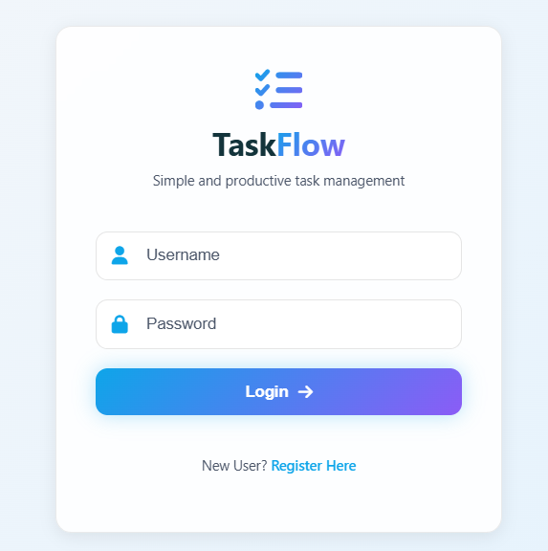
SAMPLE OUTPUT
Fig1:-HOME PAGE

Slide 13
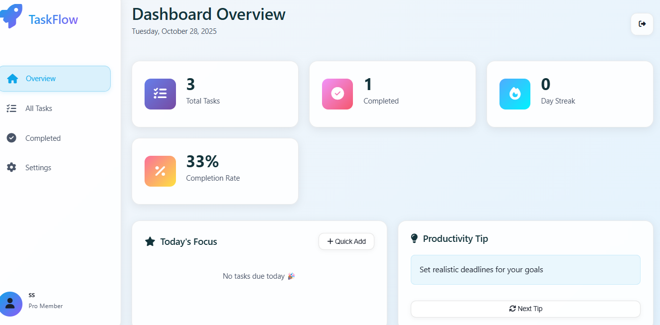
DASHBOARD PAGE

Slide 14
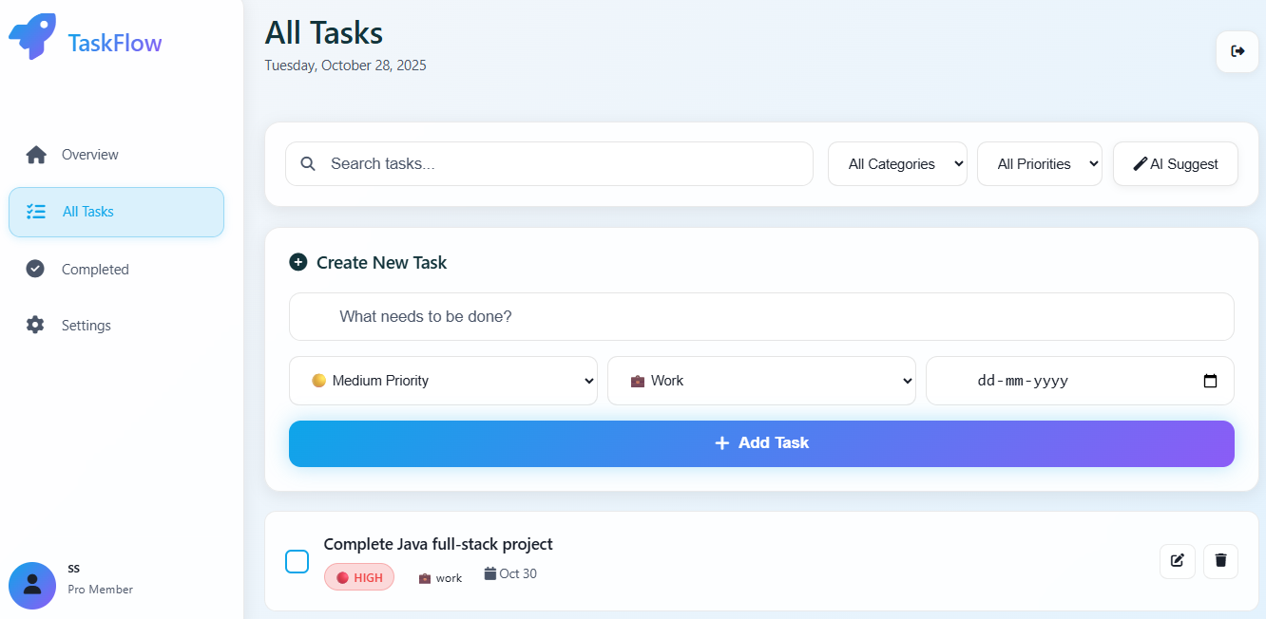
TASK PAGE

Slide 15
CONCLUSION
This system helps users stay organized and finish tasks on time. It solves many problems like poor task tracking and lack of motivation. In the future, cloud syncing, mobile apps, better AI suggestions, and team features can be added. It is great for both students and professionals who want an easy and effective way to manage work.

